Slide 1
PROJECT 6
Bank Loan Case Study
Rikin Correya

Slide 2
Project Description
1. Perform Exploratory Data Analysis (EDA) to assess how various consumer attributes influence the likelihood of loan default. The goal is to uncover insights from the data that can inform risk assessment strategies.
2. Identify patterns of loan default by analyzing the key factors driving these outcomes. Strong indicators of default will be pinpointed through detailed examination of the data.
3. Handle missing data, detect outliers, and address data imbalances as part of the analysis. Provide a thorough explanation of findings from univariate, segmented univariate, and bivariate analyses to understand consumer behavior and risk factors.
4. Determine the top 10 correlations between clients facing payment difficulties and all other cases. This analysis will help identify key relationships in the data and better understand the factors associated with default.
* All the Excel Files links are provided on Slide 5 after “Approach” Section. *

Slide 3
Tech_Stack used
MS Excel
It was used in order to open the .csv file, cleaning the data and then applying statistical functions on the useful data to analyse, as well as a very important tool in order to draw insights out of the data in form of tables and charts.
Google Slides
It was used to prepare the report and to document all the insights of different tasks of the project.
PyCharm
It was used to plot graphs with ease & less tediousness using Seaborn Visualization.

Slide 4
Approach
IMPORTING THE DATA & PYTHON LIBRARIES, & UNDERSTANDING DATA
MANAGING THE NULL VALUES BY EITHER REMOVING OR IMPUTATION
IDENTIFYING OUTLIERS
IDENTIFYING DATA IMBALANCE
VARIOUS ANALYSIS FOR INSIGHTS & PLOTTING CHARTS & GRAPHS FOR VISUALIZATION
FINDING CORRELATION
MAKING THE REPORT FOR BETTER STORYTELLING

Slide 5
Links to Files
Note - Its a .xlsx file format, hence you may see certain things not shown properly if you open it on google sheets. So it’s recommended to download the file and open it in Excel.
Datatset 1 (Cleaned_Final_Data ) - application_data.xlsx
https://docs.google.com/spreadsheets/d/16QFHvLeZmymi_o_lIQgjX5Fa5H6rsTMF/edit?usp=sharing&ouid=109416836118642236108&rtpof=true&sd=true
Datatset 1 (Data_Analysis ) - application_data_CLEANED_DATA_ANALYSIS.xlsx
https://docs.google.com/spreadsheets/d/1ho9GOZLKl-Com8XLYysTr2HgVvNco4AK/edit?usp=sharing&ouid=109416836118642236108&rtpof=true&sd=true
Datatset 2 (Cleaned_Final_Data ) - previous_application.xlsx
https://docs.google.com/spreadsheets/d/1ZeKWFMuH2HuCYVPqSBtB8CAfMaEqAC7m/edit?usp=sharing&ouid=109416836118642236108&rtpof=true&sd=true
Datatset 2 (Data_Analysis ) - previous_application_CLEANED_DATA_ANALYSIS.xlsx
https://docs.google.com/spreadsheets/d/1fW1oIdzG3xywKGnDy1Gow5L99xinuxGZ/edit?usp=sharing&ouid=109416836118642236108&rtpof=true&sd=true
Python file for plotting FLAG_DOCUMENTS
https://drive.google.com/file/d/1ZHoqIQHYJHZoKyAX7zK9NjaOyQ3hIwL-/view?usp=sharing
Python file for Correlation matrix
https://drive.google.com/file/d/147w3NO4ukgQY1dfedOnL1M5JuEk-JycU/view?usp=sharing

Slide 6
TASK A - Identify Missing Data and Deal with it Appropriately
Dropping columns with high missing value percentage
Removing unwanted columns
Data Imputation
Standardizing Data
We can observe that there are certain columns having more than 40% Null data values in the columns, hence as per Industry standards, columns with 40-50% null value are considered unusable data, thus we delete all those columns having null data points more than 40%.
Many columns had repetitive data with more than 70% of the entries being same, or out of context unrelatable columns, which was of no use for analysis, hence removed those columns for better cleaned data.
Replacing Null values with Median or mode for numerical columns, or filling those up with “Unknown” for categorical columns.
Standardizing every data points across the table for a uniform analysis.

Slide 7
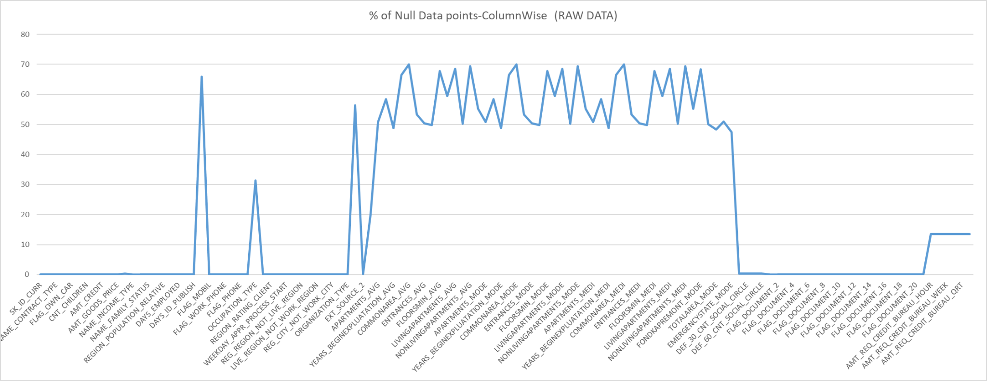
Dropping columns with high missing value percentage
DATASET 1 - application_data
We can observe that there are certain columns having more than 40% Null data values in the columns, hence as per Industry standards, columns with 40-50% null value are considered un-usable data, thus we delete all those columns having null data points more than 40%.

Slide 8
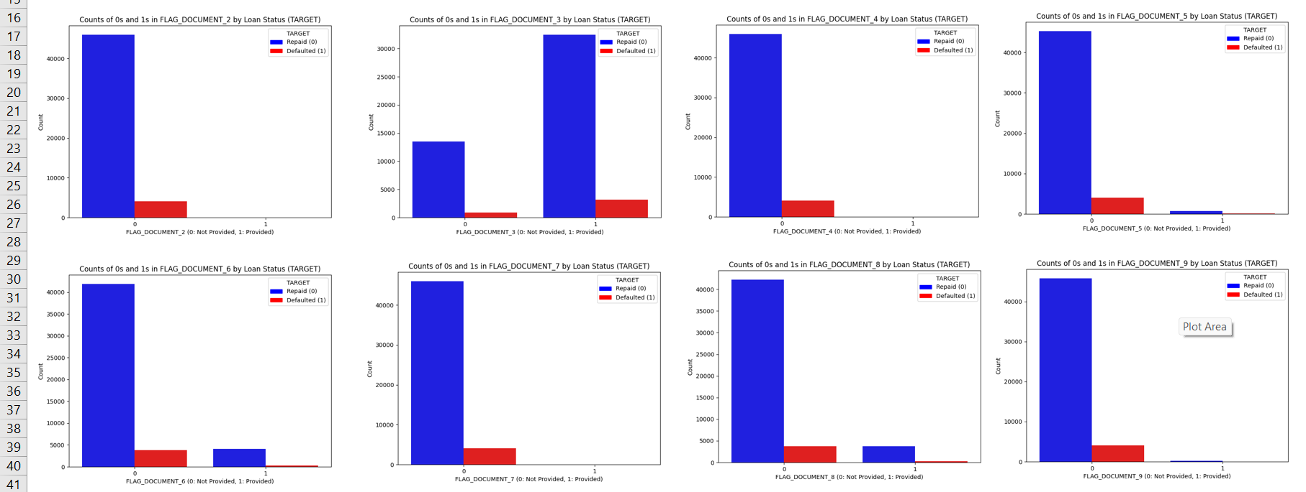
Removing unwanted columns
Below added are the images produced by my python program using Seaborn Library which shows a bar graph of Documents with 1/0 versus the TARGET 1/0. This gives us an overview of which documents are mostly consisting of 1 or 0. ( DOCS - 2,4,5,7,9,10,11,12,13,14,15,16,17,18,19,20,21) CAN BE DELETED.
I noticed that there are about 20 documents columns containing 1/0 as an entry for provided/not provided document.

Slide 9
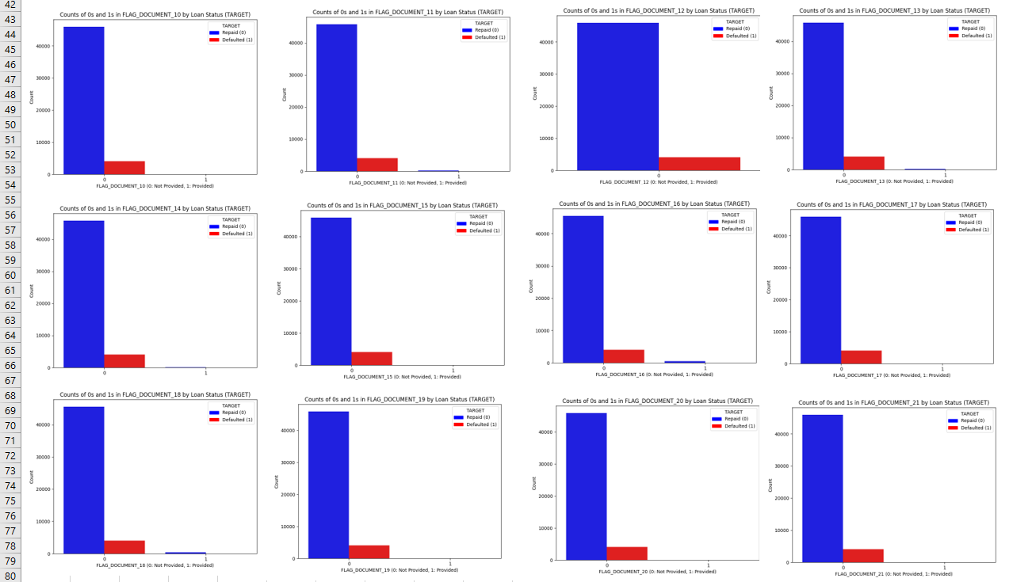

Slide 10
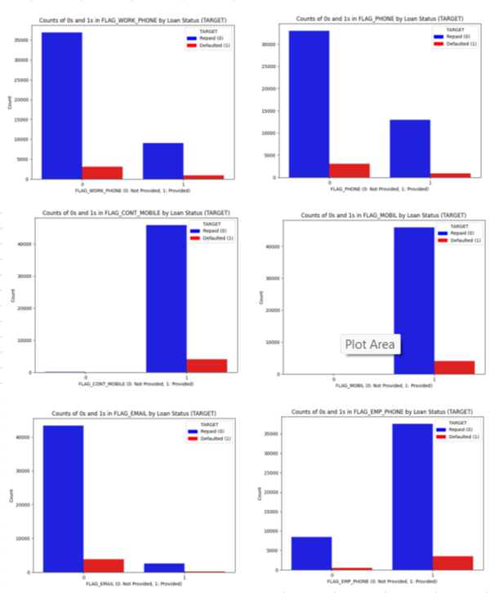
Similarly other FLAG Columns with 1/0 can be removed if it's redundant and not important. Like - MOBILE & CONT_MOBILE (as no one seems to provide a wrong mobile number)
-> All these graphs are available in the excel sheets provided at the start of the slide. (I have also provided the python code for the same, through which this visualization was created)

Slide 11
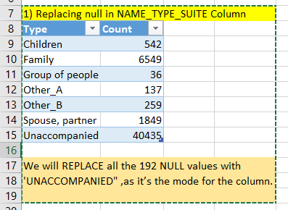
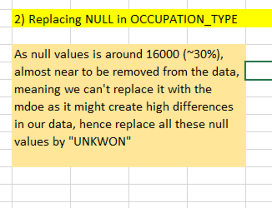
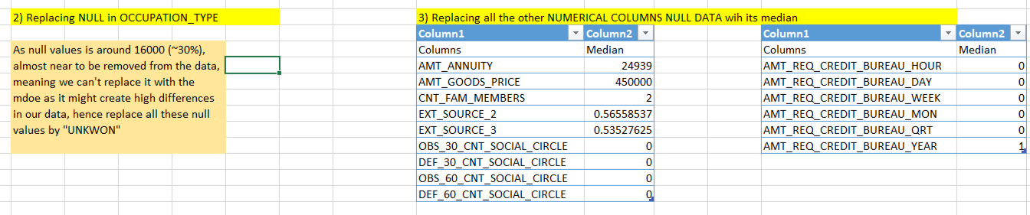
Data Imputation

Slide 12
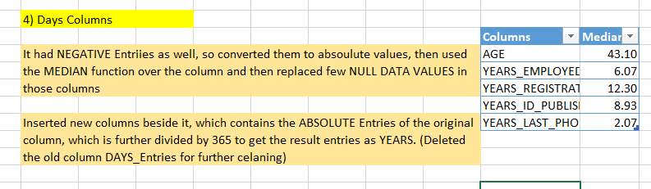
Standardizing Data

Slide 13
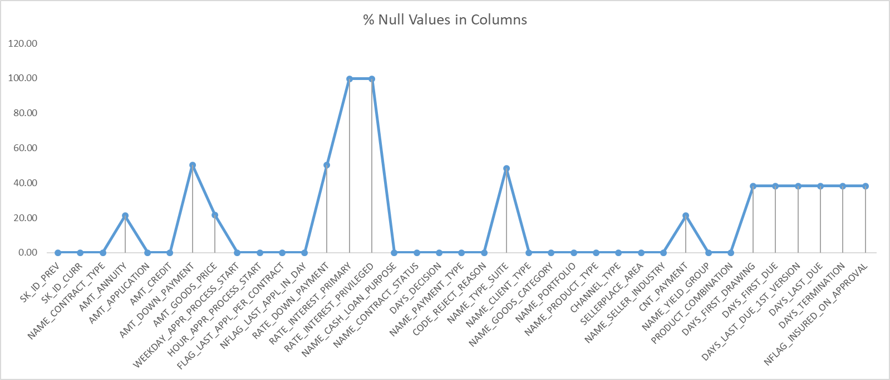
Dropping columns with high missing value percentage
DATASET 2 - previous_application
We can observe that there are certain columns having more than 40% Null data values in the columns, hence as per Industry standards, columns with 40-50% null value are considered un-usable data, thus we delete all those columns having null data points more than 40%.

Slide 14
Removing unwanted columns
Moving Forward I used the previous processed table for further cleaning. I noticed that there are 3 columns containing 1/0 OR Y/N as an entry.
As per Analysis, if row is flagged for more than 70% customers than there is no point in analysing the data to find a correlation or a pattern with the TARGET, as the Variance is very low. Also, because of this redundancy , that column might not be a strong predictor of loan outcomes as well. Hence, in best practice it can be removed. In our case columns 1) FLAG_LAST_APPL_PER_CONTRACT 2) NFLAG_LAST_APPL_IN_DAY are removed, as both these columns has count of Y and 1 respectively more than 99%.

Slide 15
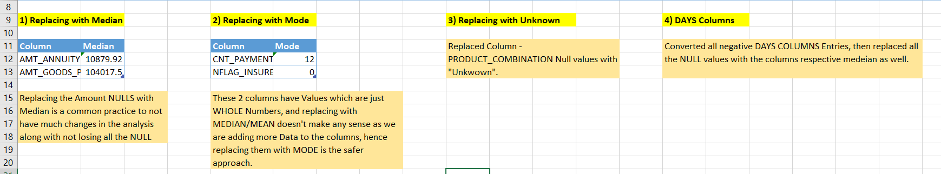
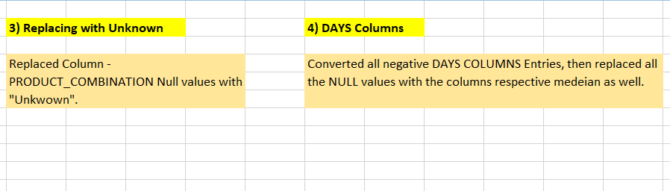
Data Imputation & Standardization

Slide 16
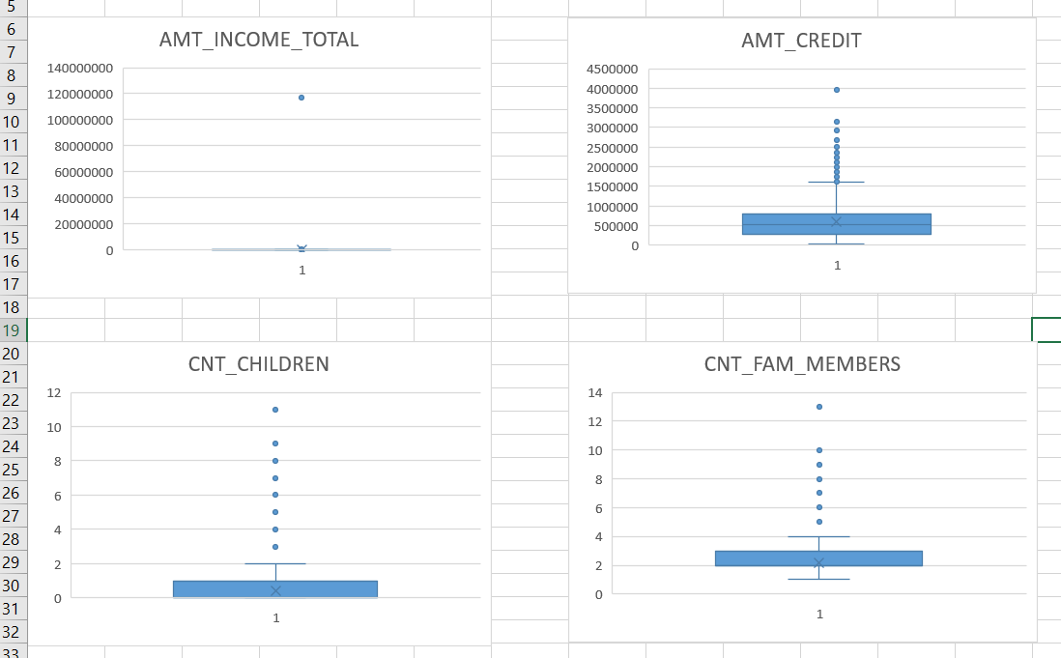
TASK B - Identify Outliers in the Dataset
DATASET 1 - application_data
After looking at the column descriptions we can rule out most of the columns in detecting outliers as those columns just have a binary entry, alphabetic entry or entry as ratings(1,2,3). We have some numerical columns which can potentially contain OUTLIERS, hence we create a BOX_PLOT chart for those columns to identify any outliers.

Slide 17
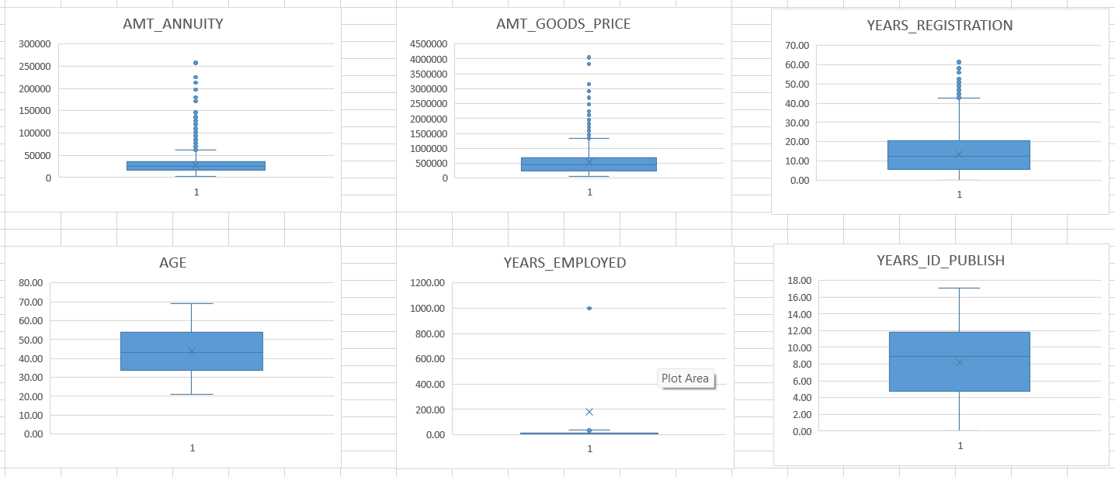
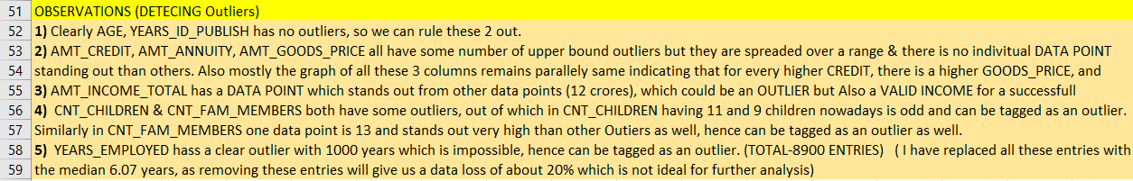

Slide 18
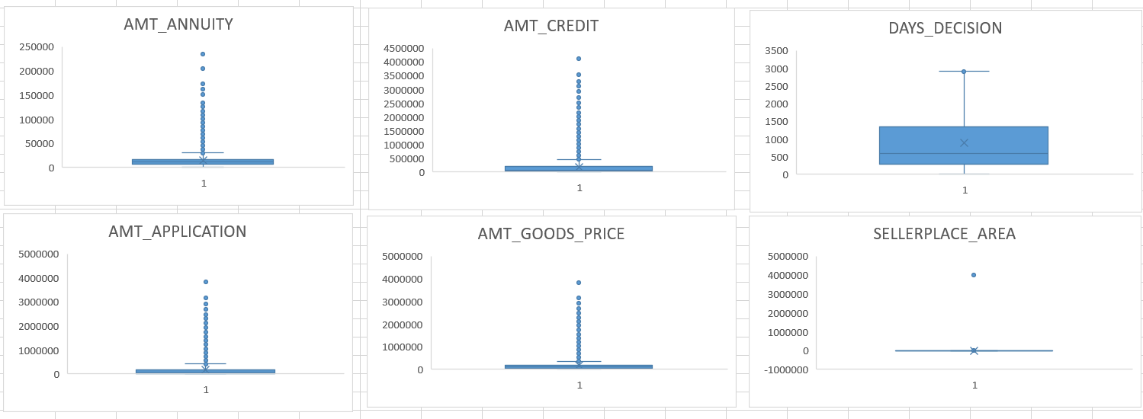
DATASET 2 - previous_application
Removed the outlier from the Sellerplace_Area, as it was an outstanding error in the column.
The number of outliers in column Amt_Annuity, Amt_Credit, Amt_Application & Amt_Goods_price are very high but they are spreaded across, hence no single data is standing as an outside, and they are highly correlated as well.

Slide 19
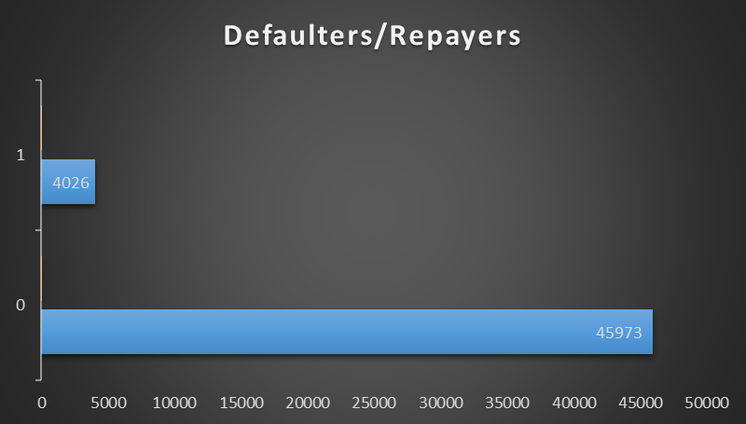
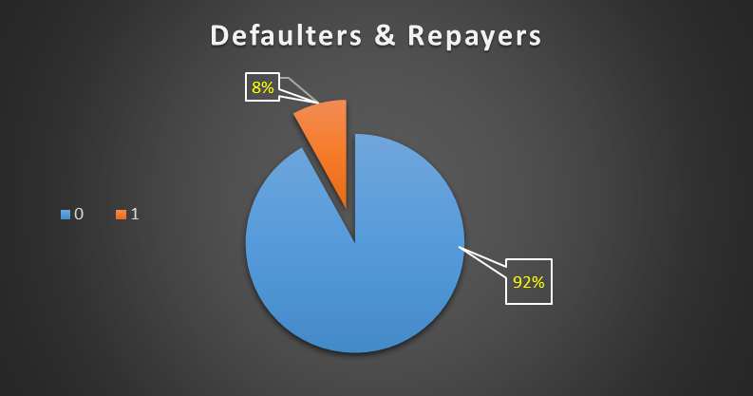
TASK C - Analyze Data Imbalance
Target | Count | %
0 | 45973 | 91.95%
1 | 4026 | 8.05
0 - Repayer
1 - Defaulter
The FINAL_DATA for anaylzing contains -
Columns - 54
Rows - 49,999

Slide 20
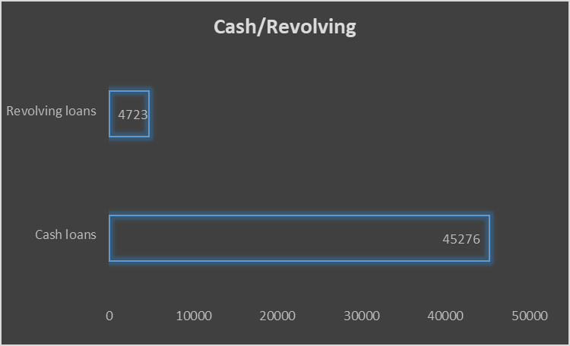
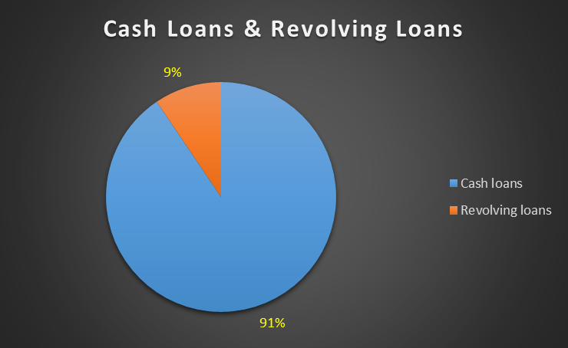
NAME_CONTRACT_TYPE | Count | %
Cash loans | 45276 | 90.55%
Revolving loans | 4723 | 9.45%

Slide 21
TASK D - Perform Univariate, Segmented Univariate, and Bivariate Analysis
ANALYSIS
Univariate
Segmented Univariate
Bivariate

Slide 22
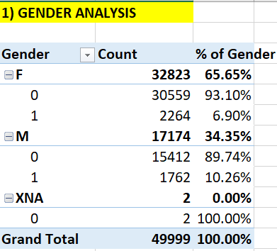
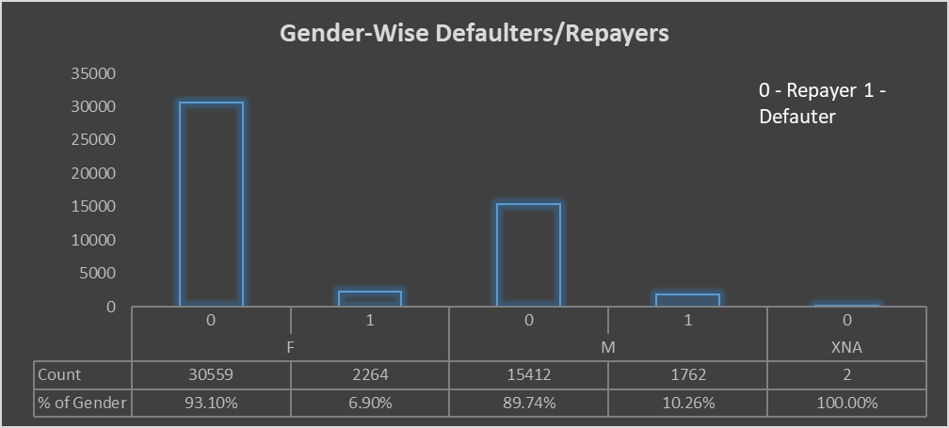
DATASET 1 - application_data
Univariate & Segmented Univariate
Higher % if Defaulters in MALE, even being lesser number of loan applicants, whereas , higher % of Repayers is seen in FEMALE.

Slide 23
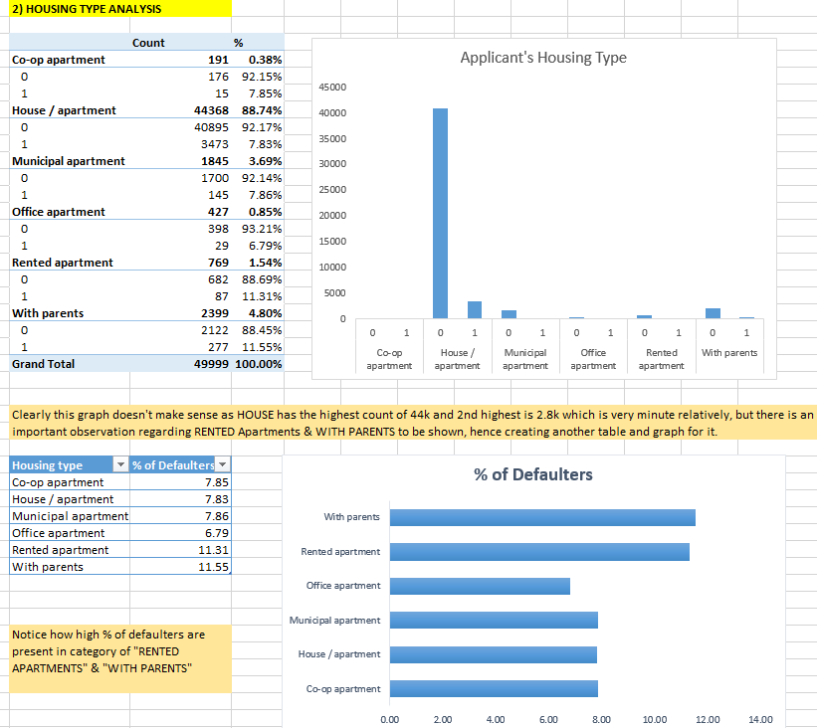

Slide 24
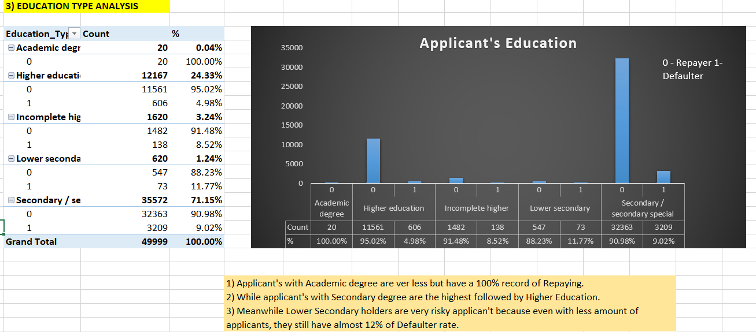

Slide 25
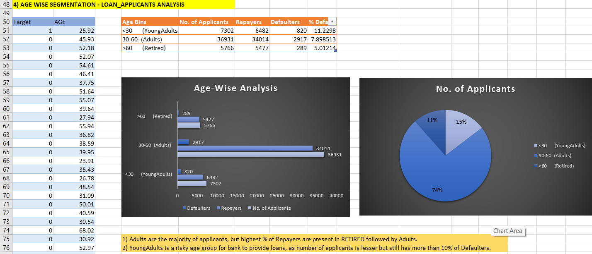

Slide 26
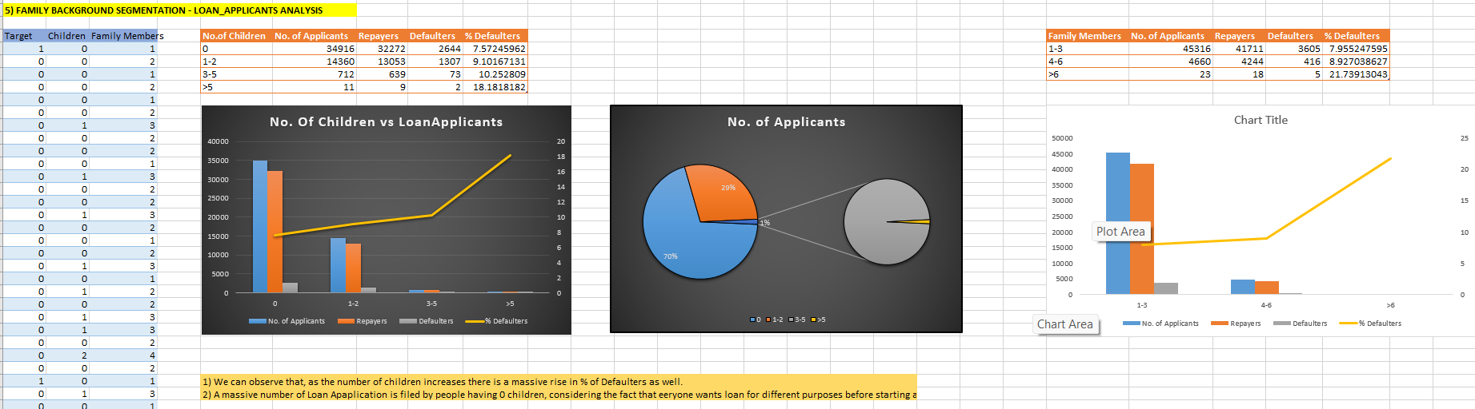

Slide 27
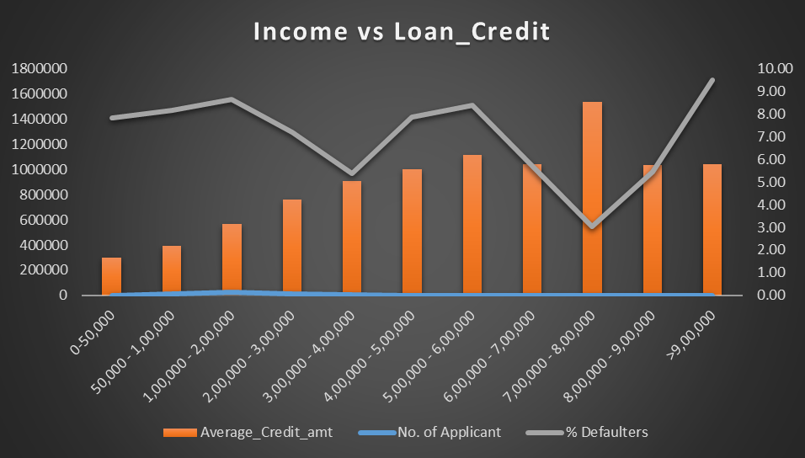
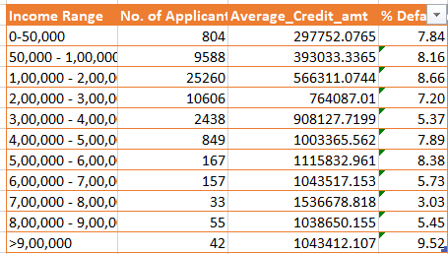
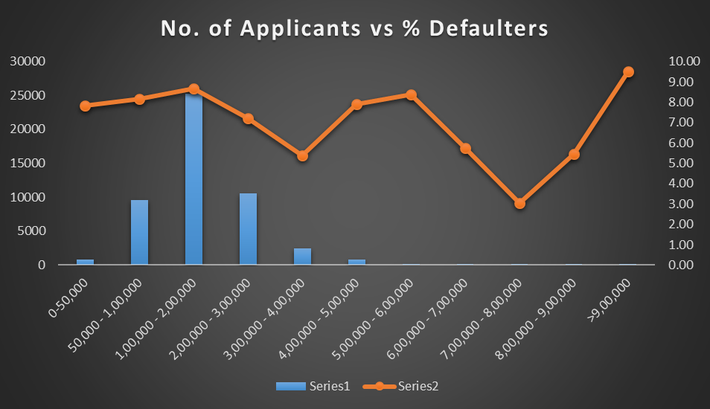
Bivariate Analysis
1) Annual Income vs Amount Credit
1) As the income rises, the credit amount of the loan rises as well. Hence, higher the income, higher the loan amount approved by bank.
2) While the highest average is not of the highest income range( The income range(7-8 lakhs) has the highest, while (>9 lakhs) is second).
3) With the rise in applicants, the % of increases in defaulters is common but for the applicants with incomes between 4 to 6 lakhs is very high as compared to other ranges, and the income range of >9 lakhs has the highest % of defaulters.

Slide 28
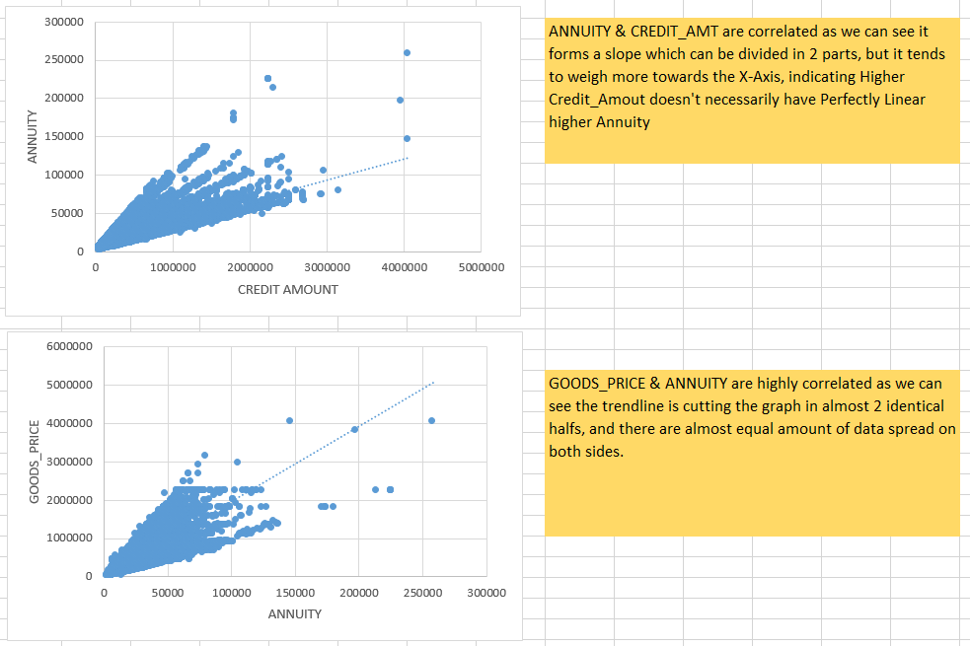
2) AMOUNT COLUMNS RELATION ANALYSIS

Slide 29
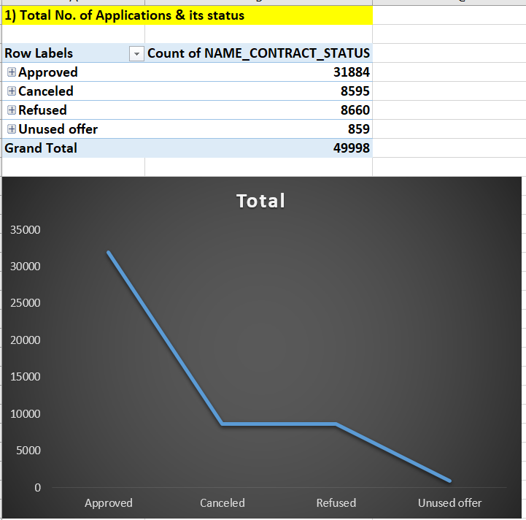
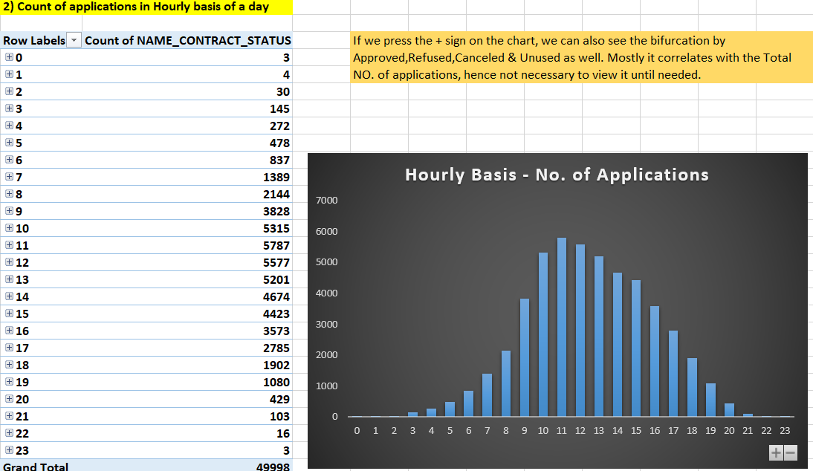
DATASET 2 - previous_application

Slide 30
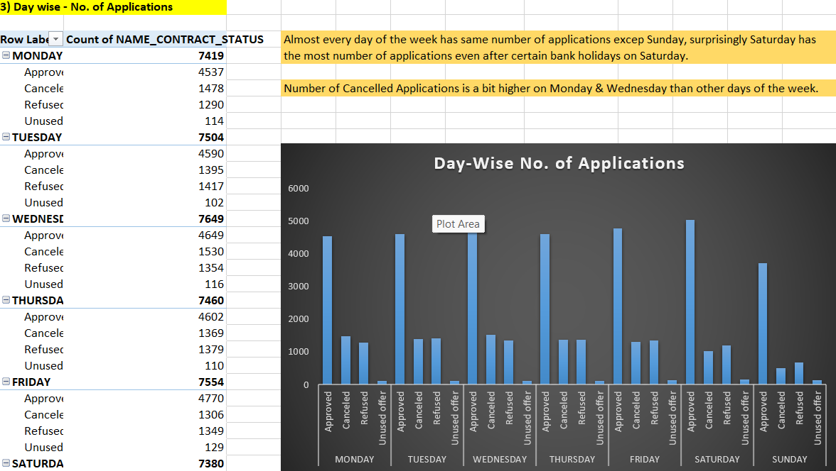

Slide 31
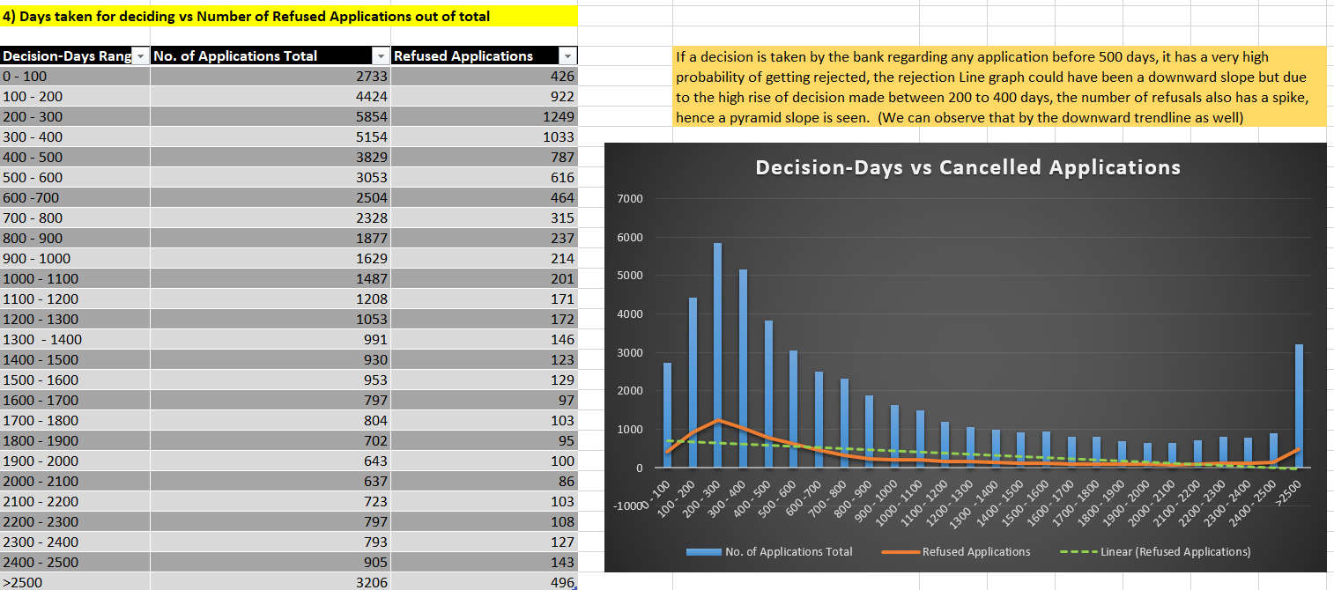

Slide 32
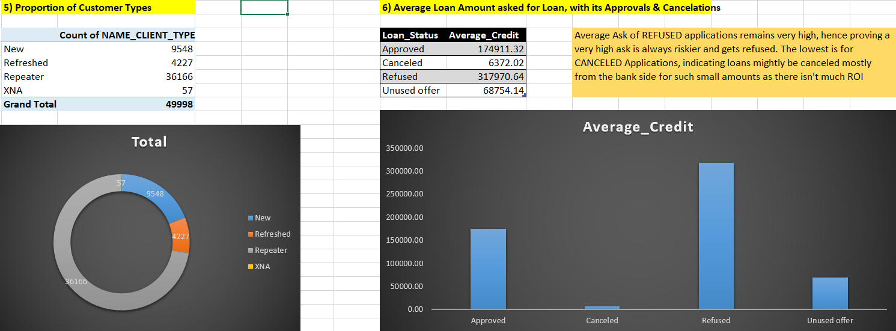

Slide 33
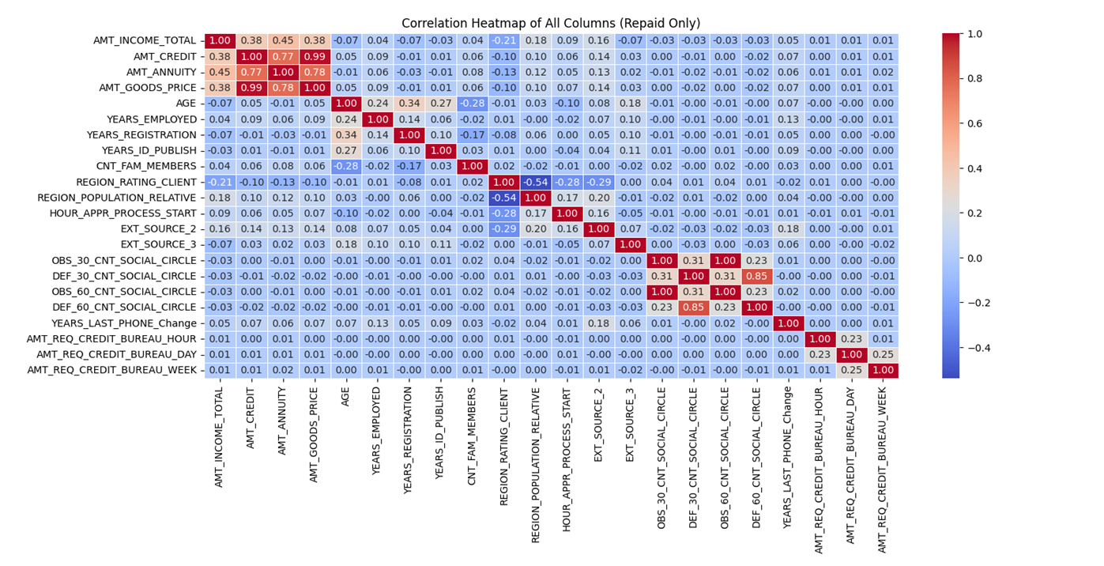
TASK E - Identify Top Correlations for Different Scenarios
REPAID

Slide 34
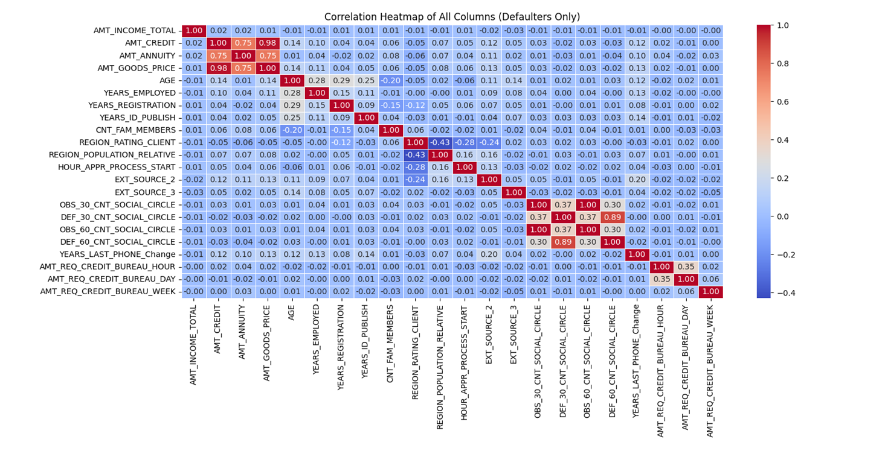
DEFAULTERS

Slide 35
Result
In this case study,
I applied the EDA to analyze patterns in the data.
Before starting the project, I read some case studies & articles to get some knowledge on risk analytics in banking and financial services.
I can understand how data can help to reduce the risk of financial losses when extending loans to customers.
This case study has assisted me in acquiring the skill of summarizing extensive datasets to extract valuable insights and to understand correlation & its importance in data analysis.
I gained knowledge about data imbalance, outliers, and the underlying factors influencing the datasets.

Slide 36
THANK YOU
Note -> I couldn’t record Loom Video for more than 5 minutes, so I have used another online recorder, whose link i have provided in the VIDEO LINK while submitting.
Steps to watch my video - Click on the Video Link provided -> Then they will ask to Sign in, so if you are new then Sign in to the account -> after creating an account,you will be on the dashboard. -> Then again go back to my My VIDEO LINK and click it again, then it will load for 2 - 3 minutes, as it's a 46 minute video.
Video link - https://app.recorditor.com/recording/2056a2c72cb60a0cc3db6053289e184a50c14247ea660b874957a112130c78dd596c1810407f54d29767eddaa7d8b5f4f2cd44cb7682881a56f0b11a859ed295

